Slide 1
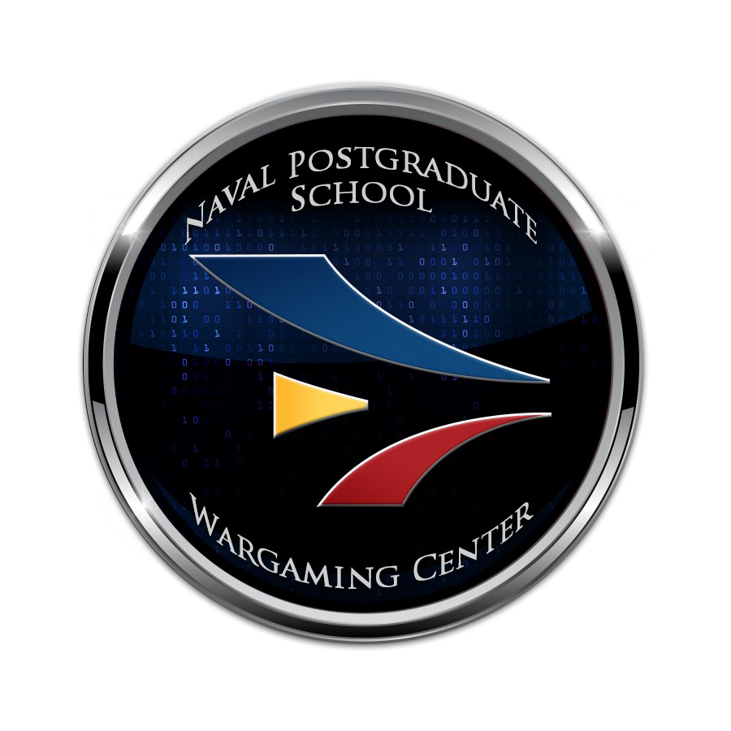
Wargaming at NPS
Jason Perry, Director, NPS Wargaming Center
LTC Charles Rowan, Director, MOVES Institute
Updated 10 Apr 2025 Unclassified

Slide 2
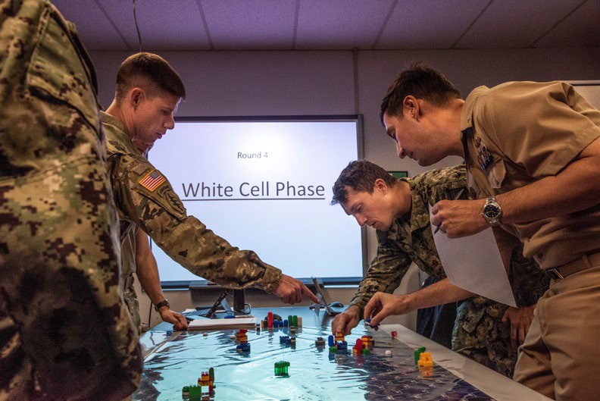





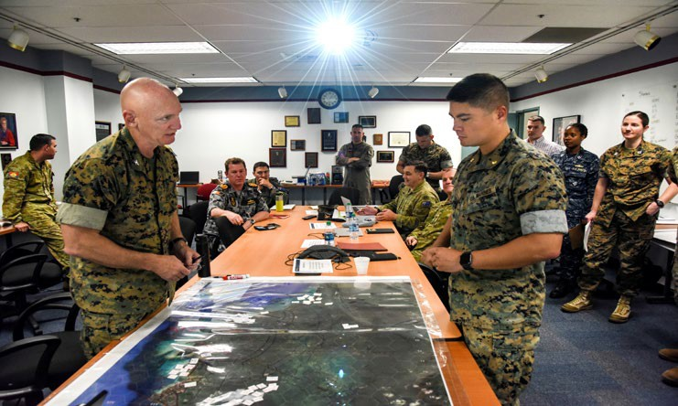
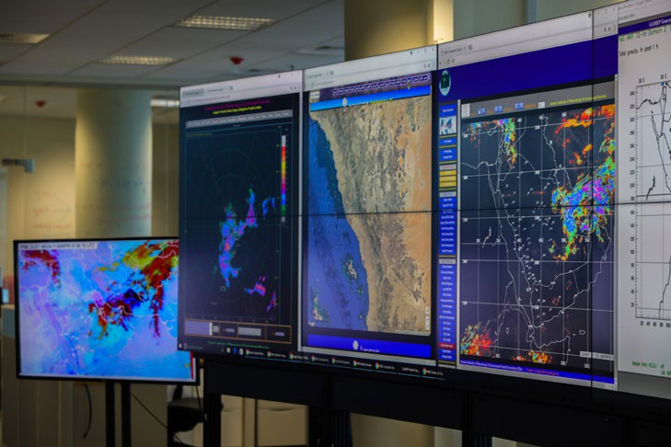
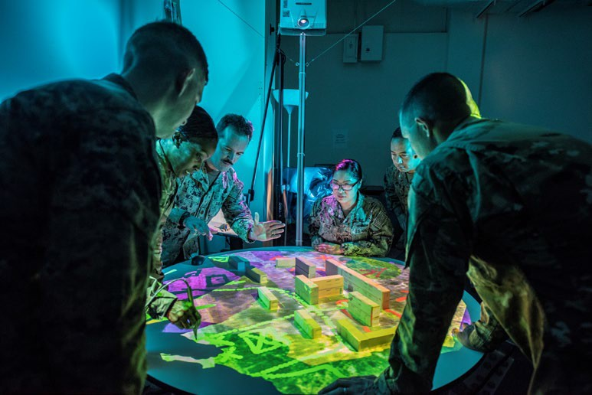
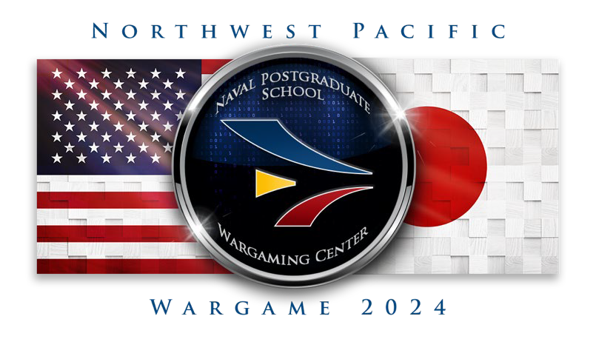



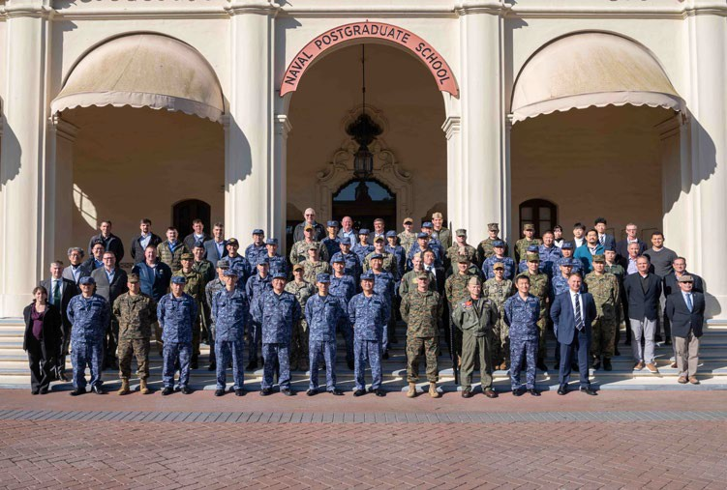

NPS Wargame LOEs
Applied Research
Educate Warfighters
Execute Wargames
Innovate

Slide 3

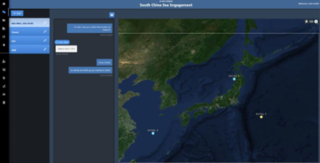
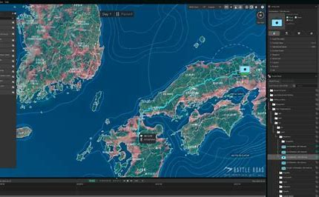
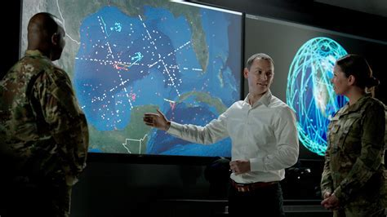
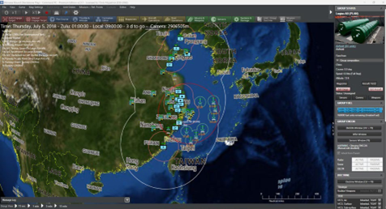
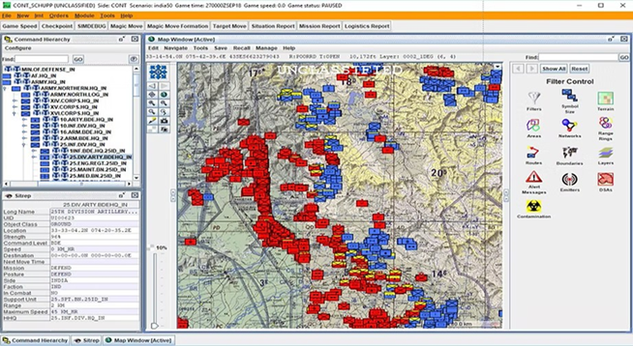
Wargame Information Flow
Execute
Orient
Plan
Input
Execute
Inputs
Road to Conflict
Scenario / Vignettes
Blue OOB
Green OOB
White OOB
Red OOB
SOPs
Process
Wargame Facilitation Tool
Wargame Network
OUTPUTS
M&S Tools
JTLS-GO
MAST
Command PE
AtomEngine
RCADE
SWIFTR
RFIs, RFSs, ConOps, Task Ords, Questionnaires, &
Simulation
Supportable
Data
Player
Decisions
SME Adjudication
Receive
Process
Analyze
Decide
Update
NWPAC Move-Step
Sim Informed Adjudication
Next Move
Updates
Move Outcome
Final Report
Data Collection & Analysis Plan (DCAP)
Post-Game Analysis
Data Collection Plan

Slide 4
Research & Collaboration
Innovate
The Modeling Virtual Environments and Simulation (MOVES) Institute at NPS developed SWIFTR – a wargame facilitation tool – used by the over 650 players participating in a recent wargame.
NPS developed 5x Cooperative Research and Development Agreements (CRADA)
  Leverage existing M&S tools
  Experiment with new M&S systems
  Integration of emerging capabilities (i.e. Robotic Autonomous Systems)
  Research pathways to modernize wargaming methods
Simulation outputs informed SME adjudication
  Joint Theater Level Simulation – Global Operations (JTLS-GO) provided simulation data for joint, bilateral forces and logistical consumption across the AOR.
  MAST provided maritime engagement models
  CMD PE provided naval and air engagement models
  Saronic Technologies assisted in development of sUSV modeling characteristics

Slide 5
Future Focus
Improve the value of M&S support to wargame outputs
  Validate M&S datasets and algorithms to increase trust in outputs
  Expand to include environmental and systems effects in models
Improve player experiences – enable players to conduct wargames without learning new systems
  Develop bridging methods that leverage existing M&S tool with simplified player interface
  Leverage AI, Language Models and emerging technologies
Improve adjudication techniques
  Provide timely feedback to Commanders and Players
  Ingest M&S outputs real-time during gameplay to inform plans
  Add fidelity to adjudication outputs by informing SME processes
Notes:
White Cell chatbots, Commander Dashboards, Data Collection & Summarization, COA Analysis

Slide 6
Questions/Discussion

